Slide 1
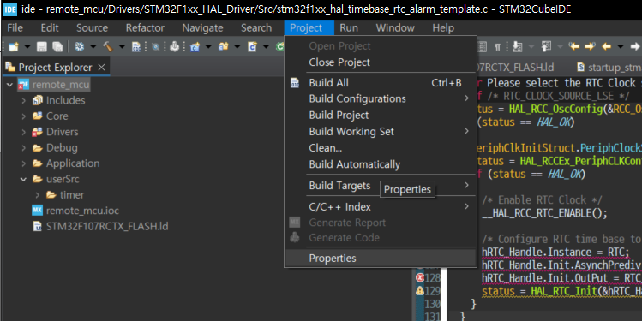
Include path 설정

Slide 2
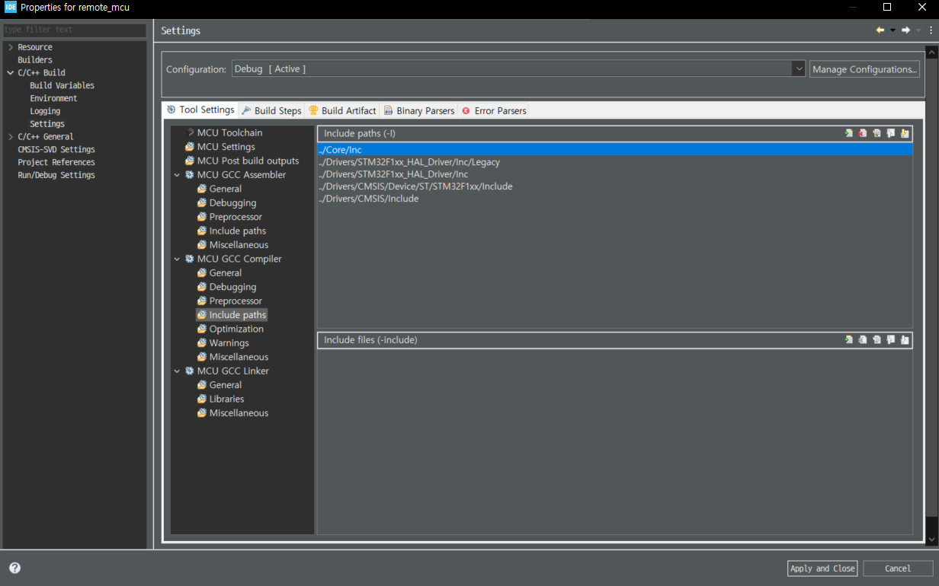
Include path 설정
c/c++ build – settings –Tool settings

